Slide 1
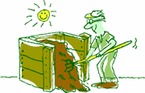
Compost: Nature's Recycling Process

Slide 2
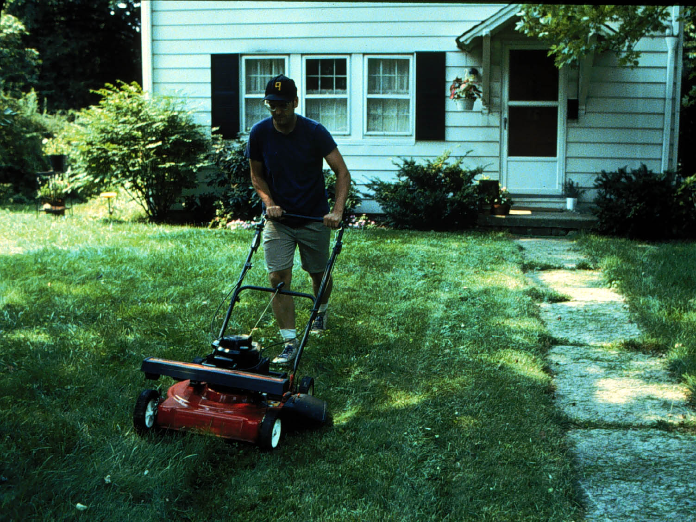
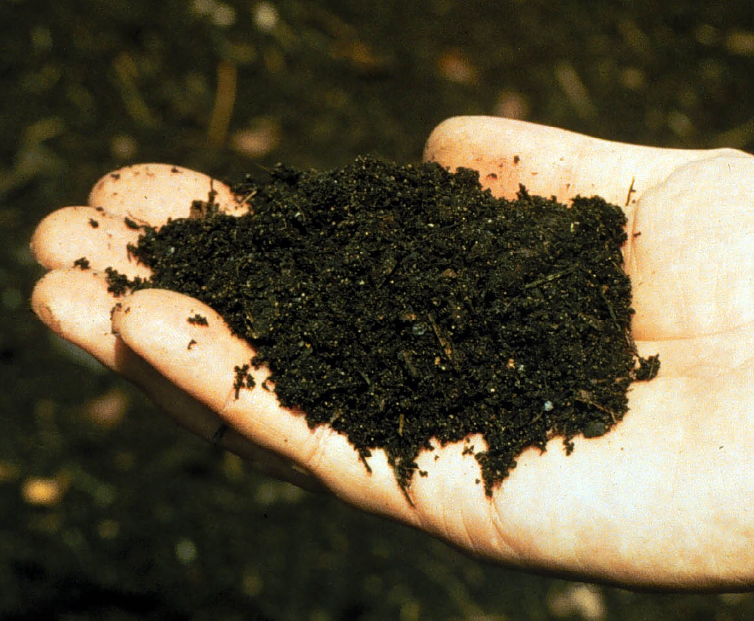
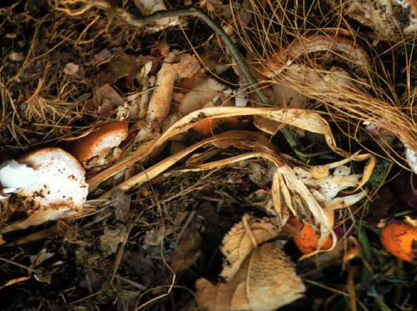
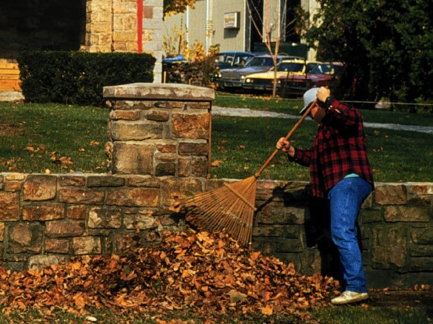
What is composting?
Using the natural process of decay to
change organic wastes into a valuable
humus-like material called compost
Compost

Slide 3
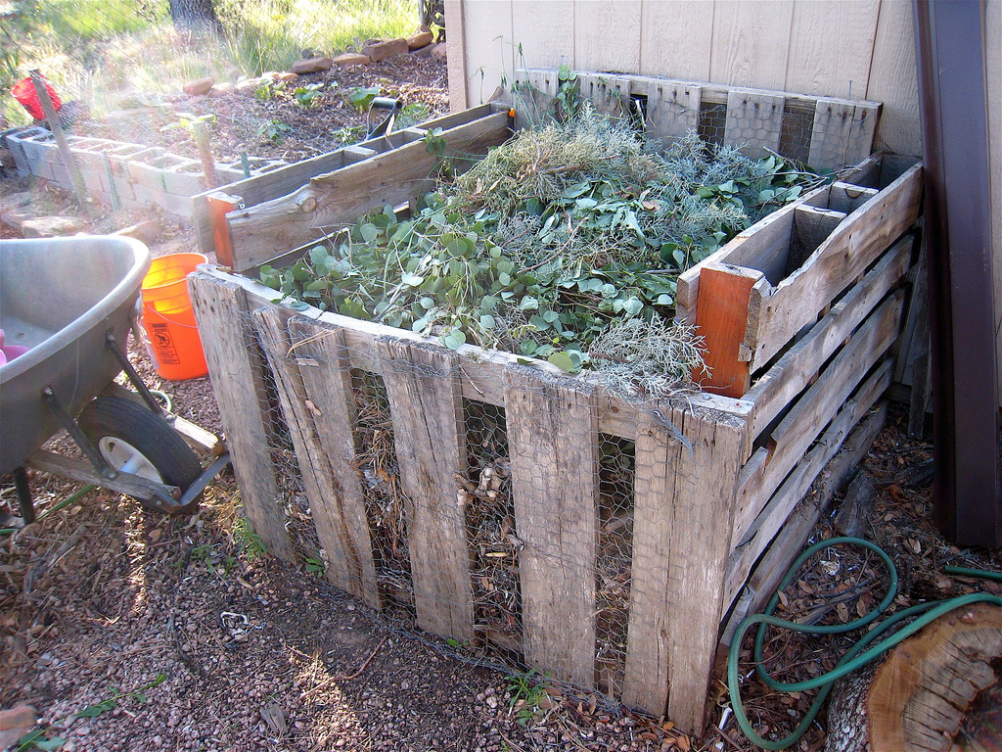
Composting:
Speeds up the natural decaying process
A compost pile or bin
allows you to control
Air (oxygen)
Water
Food
Temperature

Slide 4
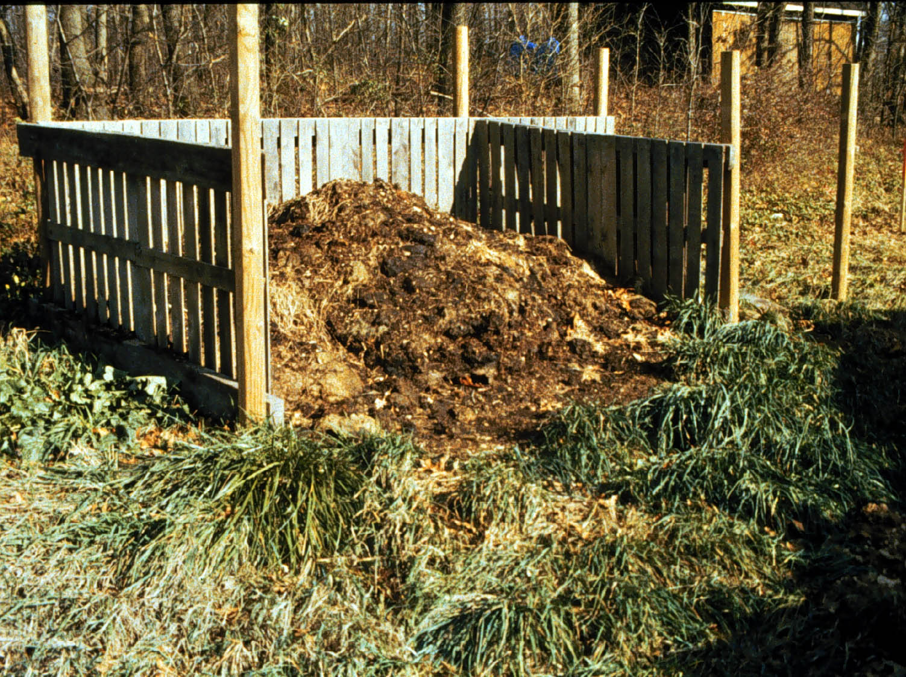
What is needed to make compost?
Microorganisms (mainly bacteria and fungi) that do all the work for you.
Where do the microorganisms come from?
Soil
Leaves
Food scraps
Cow & chicken manure
Finished compost

Slide 5
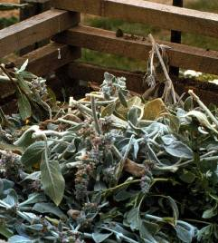


What are the good organic materials to add?
Garden trimmings
Leaves
Grass clippings
Kitchen scraps

Slide 6
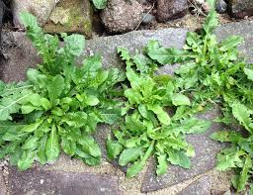
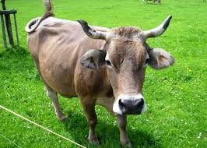
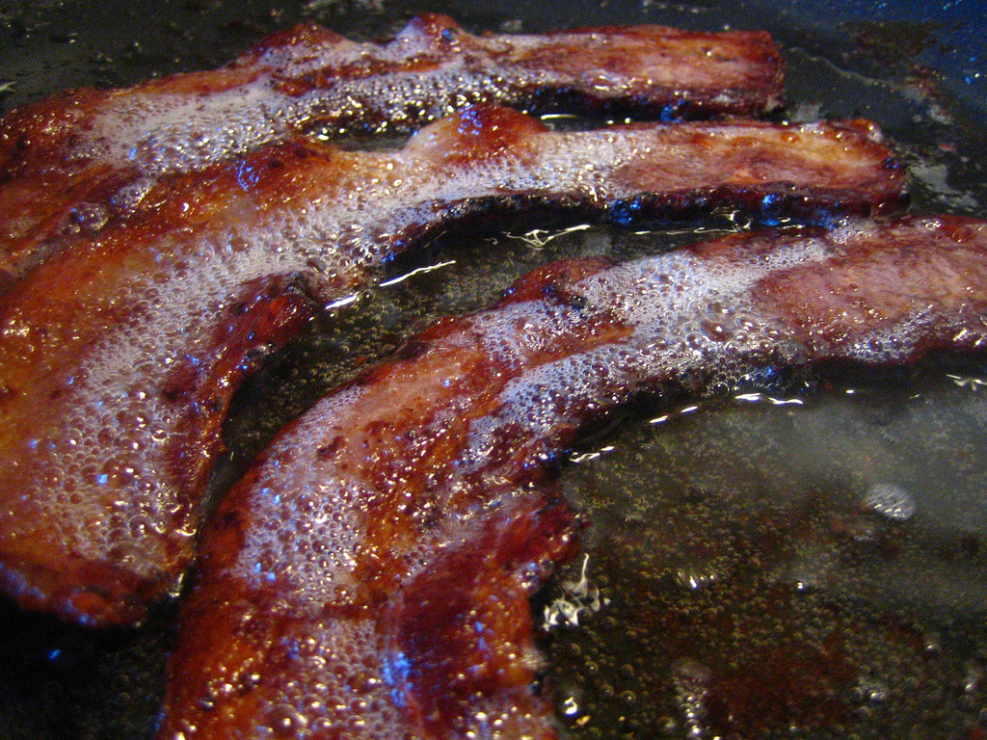
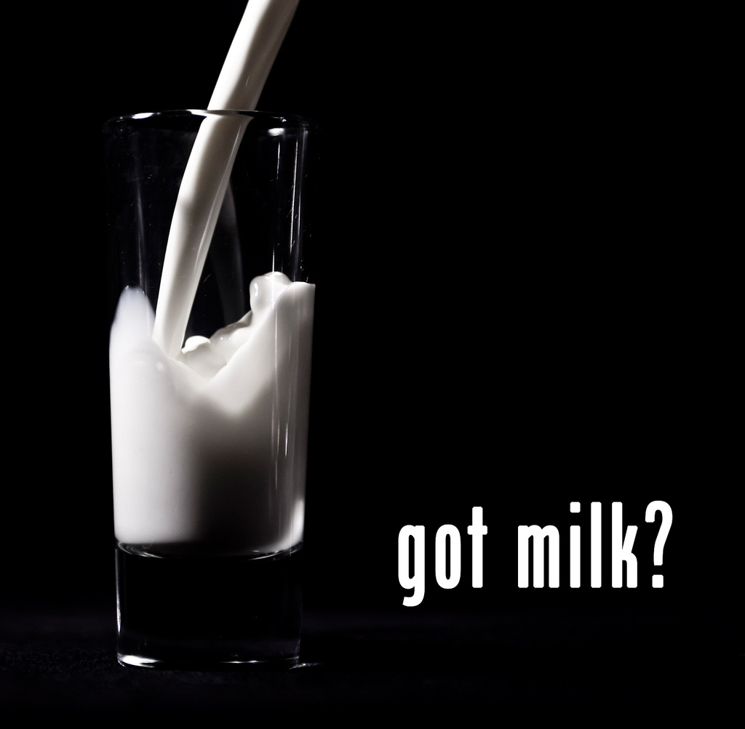
What are organic materials to avoid?
Meat
Weeds
Dairy
Grease

Slide 7
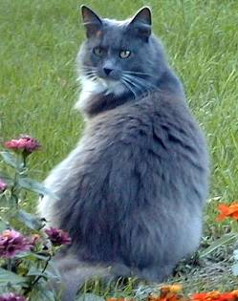
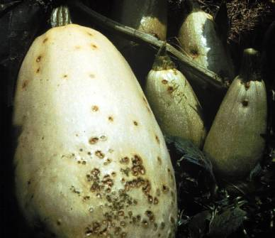
Materials to avoid…
Cat or dog waste
(attracts pests, could spread disease)
Diseased or insect ridden plants
(could infect or attack garden plants when compost is used)

Slide 8
Two Types of Materials
Two Types of Materials
Browns
Decay very slowly
Coarse browns can keep pile aerated
Tend to accumulate in the fall
May need to stockpile until can mix with greens
Greens
Decay rapidly
Poor aeration – may have foul odors if composted alone
Tend to accumulate in spring and summer
Supply nitrogen for composting
Best composting if mixed with browns
Browns
Decay very slowly
Coarse browns can keep pile aerated
Tend to accumulate in the fall
May need to stockpile until can mix with greens
Greens
Decay rapidly
Poor aeration – may have foul odors if composted alone
Tend to accumulate in spring and summer
Supply nitrogen for composting
Best composting if mixed with browns

Slide 9
Examples
Browns
Leaves
Newspaper
Computer paper
Corrugated Cardboard (without staples, tape, and labels)
Straw
Sawdust (non-chemically treated wood)
Greens
Fruit and Vegetable scraps
Grass (non-chemically treated)
Tend to accumulate in spring and summer
Supply nitrogen for composting
Best composting if mixed with browns

Slide 10
Aerobic composting
Composting with microorganisms that need air (oxygen)
The fastest way to make high quality compost
Produces no foul odors
Aerobic microorganisms produce heat

Slide 11
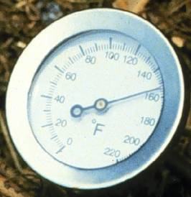
Aerobic composting and temperature
Active composting occurs in the temperature range of 55ºF to 155ºF
55
140
Pile temperature may increase above 140ºF but this is too hot for most bacteria and decomposition will slow until temperature decreases again.
155

Slide 12
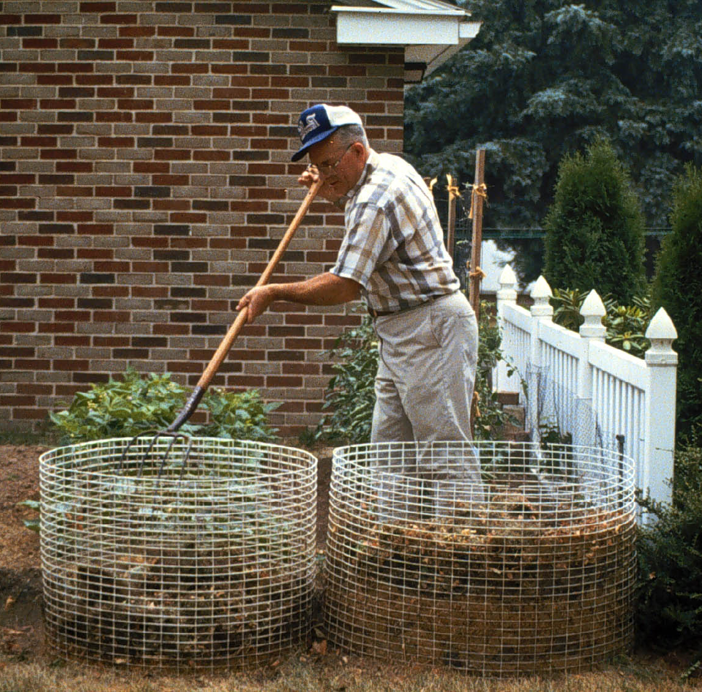
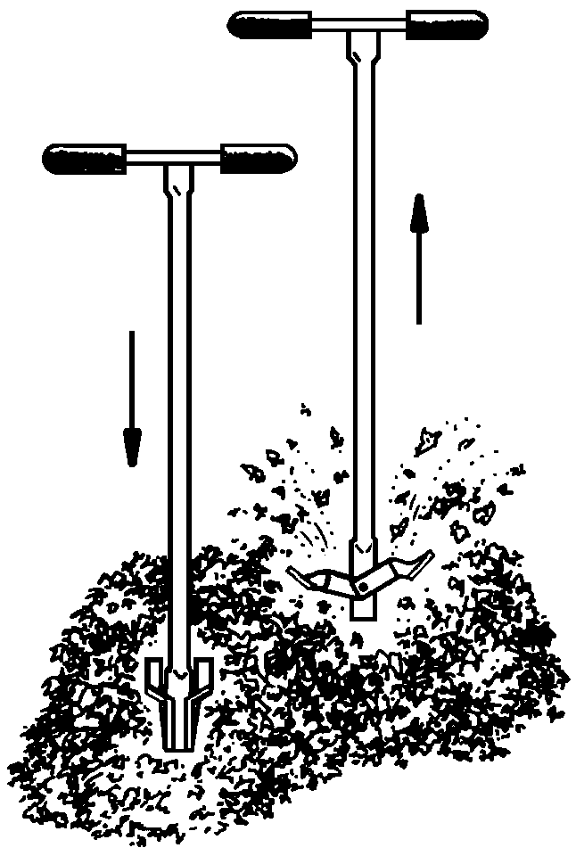
Pile aeration
Turning the pile mixes fresh air into the pile
Turning tools can make the job easier
Notes:
Turning (mixing) the pile also brings fresh, oxygen rich air into the pile.
Turning the pile is easier if you have two bins and can turn from a full bin into an empty bin.
Turning tools can also help mix the pile.

Slide 13
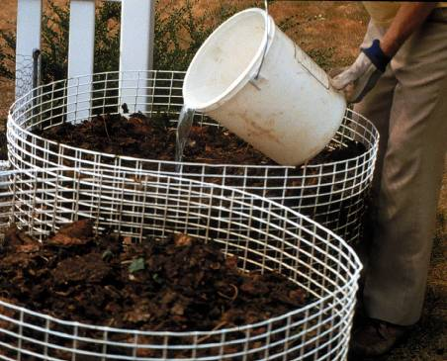
Water
Rapid decomposition requires optimum water content
  If too dry, bacterial activity will slow or cease
  If too wet, will lead to anaerobic conditions
Pile water content should be at 40-60%
As damp as a wrung out sponge
If too dry, add water as you turn the pile
If too wet, add browns and/or turn the pile

Slide 14
When is compost finished?
The color is dark brown
It is crumbly, loose,
and humus-like
It has an earthy smell
The pile has shrunk to
about 1/3 of its original volume

Slide 15
Where should I put my compost pile?
Shaded area will help prevent drying out in summer
Adequate work area around the pile
Area for storage
Water available
Near where finished compost will be used
Be a good neighbor

Slide 16
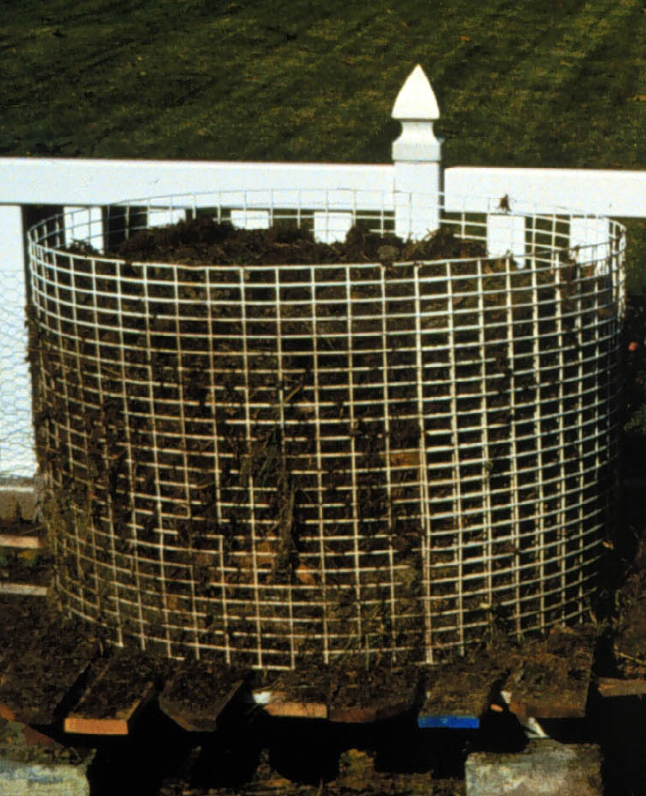
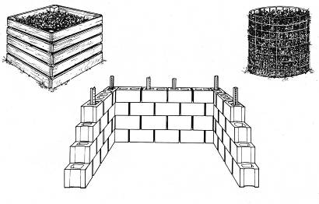
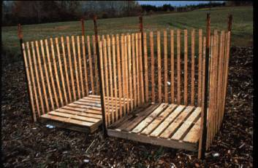
Bin/pile construction
Ideal size is approximately a 3 foot cube
  Promotes sufficient aeration
  Retains sufficient heat to maintain warm temps
  Piles larger than a 5 foot cube are difficult to turn and tend to become anaerobic in the center

Slide 17
Odors
Odors are one of the most frequent but easily avoidable composting problems.
Rotten odor
  Putrid smell or rotten egg smell
  Usually results from anaerobic conditions
  Excess moisture, compaction
  Turn pile, add dry porous material (browns), cover kitchen scraps
Ammonia odor
  Too much nitrogen (greens)
  Add high carbon material (browns), turn pile

Slide 18
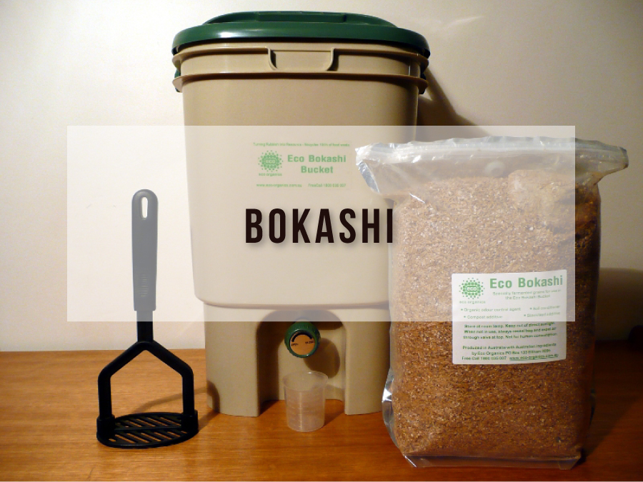
Bokashi Composting
An anaerobic process that relies on inoculated bran to ferment kitchen waste, including meat and dairy, into a safe soil builder and nutrient-rich tea for your plants.
When the bucket is full, it is sealed shut and set aside for ten to fourteen days.
Drain the “tea” every couple days
When the bucket is opened, the contents, though recognizable, are thoroughly pickled.
The “pre-compost” can be buried in a fallow spot in the garden or added to regular compost pile.
It is still so acidic that plant roots should not come in contact with it for two to four weeks.

Slide 19
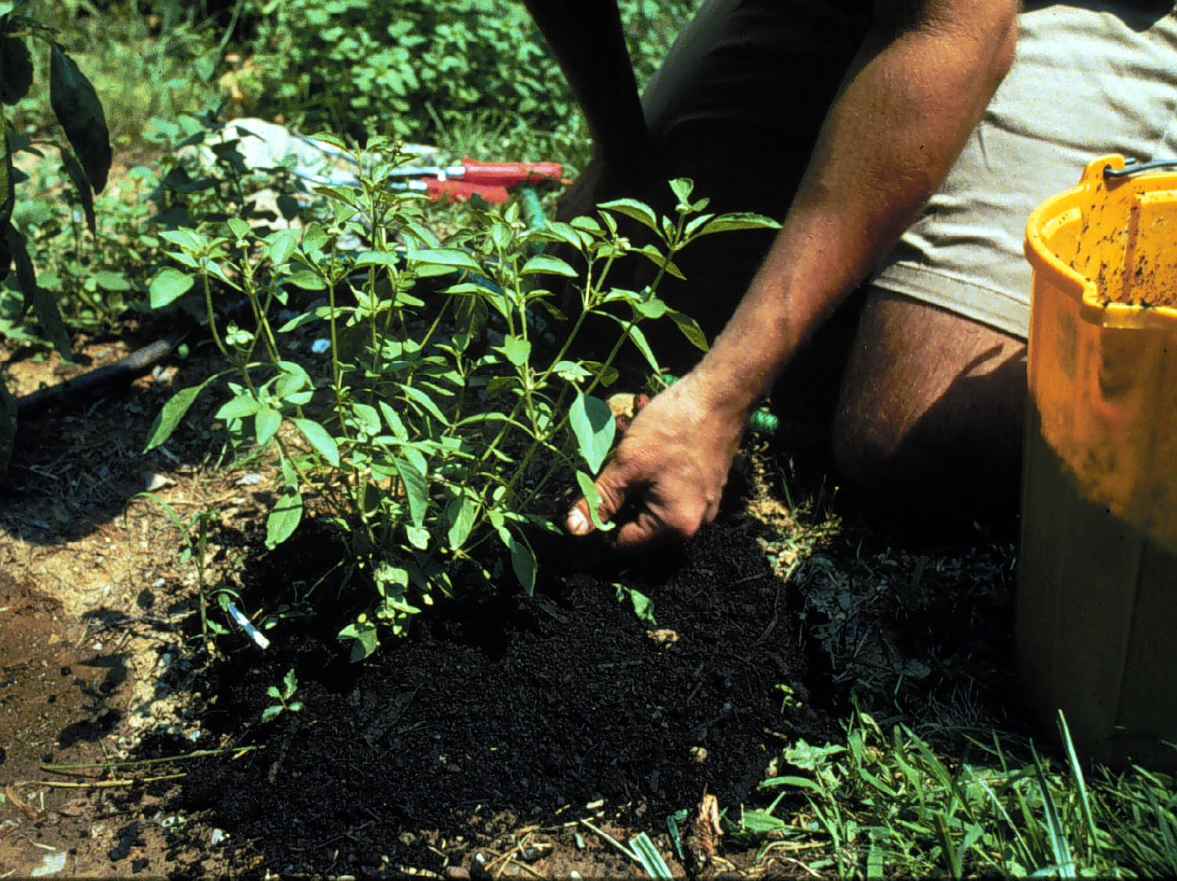
Benefits of compost
Plant nutrients
Compost is not a fertilizer, but does contain plant nutrients
Nitrogen and phosphorus are mostly in organic forms
Compost contains many trace nutrients that are essential for plant growth

Slide 20
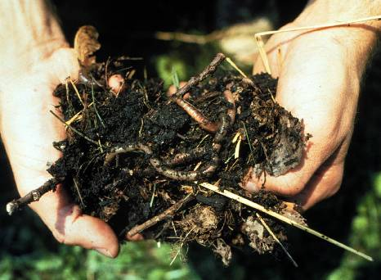
Benefits of compost
Promotes soil health
Supplies organic matter to soil
Attracts earthworms
Stimulates beneficial soil microorganisms
Increases soil water holding capacity
Increases soil nutrient retention and better drainage

Slide 21
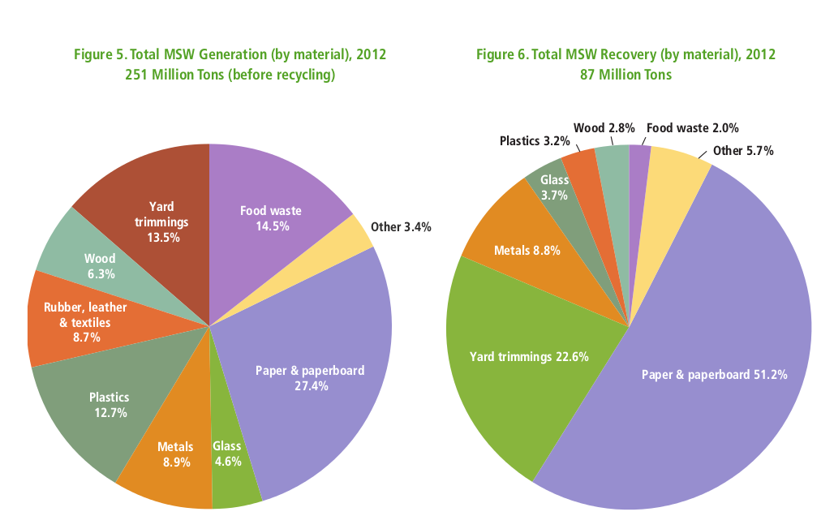
Material Solid Waste Stats from 2012

Slide 22
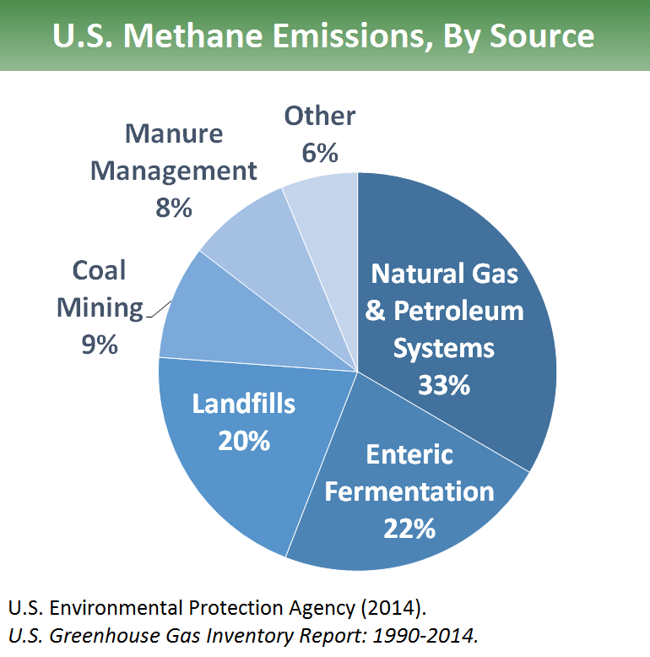

Slide 23
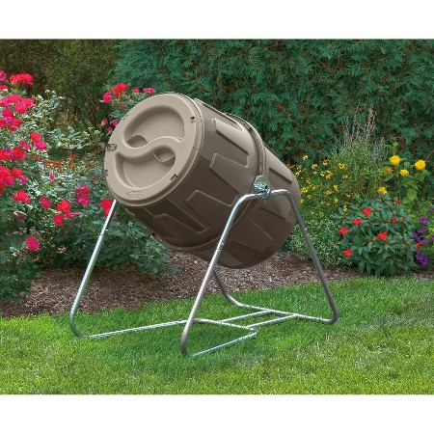
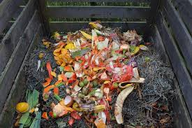
Final Thoughts

